Slide 1
STA302 Video Presentation
Avinash Dindial
Amy Jia

Slide 2
Project Problem
Given a dataset of 1508 colleges in the U.S., we must use methods of data analysis to determine the factors that best explains the variance in college admission rate.
Dataset contains both numerical and categorical data.

Slide 3
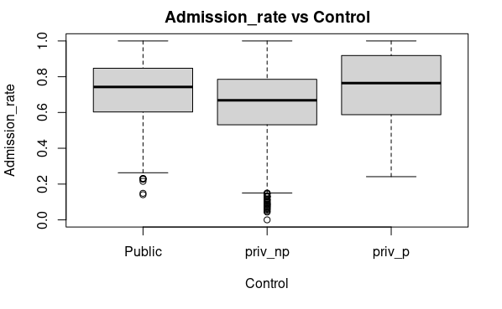
EDA
The response variable in this project is the admission rate, ADM_RATE.
The main categorical variable used is control, used to represent the type of college, seen on the x-axis.
Here we can see that private, not for profit schools have the lowest mean admission rate with multiple outliers. These outliers are schools such as Harvard known for having admission rates less than 5%.

Slide 4
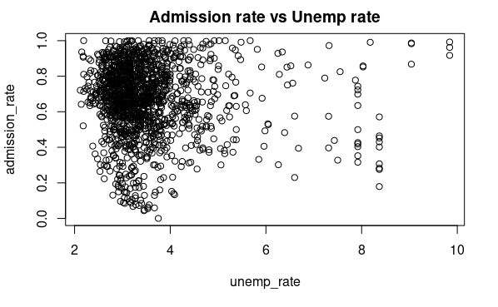
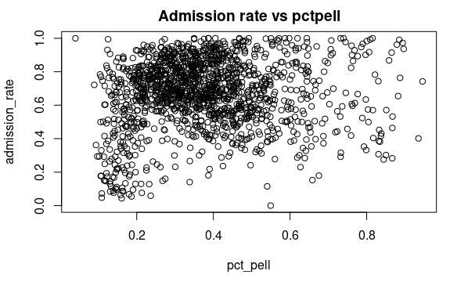
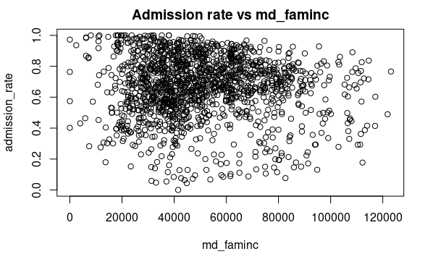
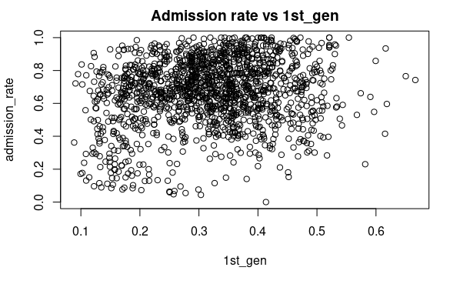
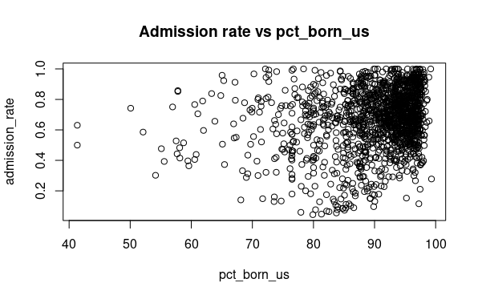
Plots of numerical variables showed no significant patterns. These are some of the variables research suggested.

Slide 5
T-tests for selecting predictors
Predictor | Adjusted R value
Full model | 0.2309802
Unemp_rate | 0.2270387
Md_faminc | 0.2291728
female | 0.2268559
Par_ed_1st_gen | 0.2289792
Pctpell | 0.2314106
Pct_black | 0.2313755
control | 0.2218453
We produced our model based on research as well as comparing p-values (cut-off value of 0.05) for certain predictors.
We then compared the adj. r values of these predictors to the full model to make sure they were related to the response. (not all are shown)
Note the values for pctpell and pct_black are bigger than the original indicating they can be dropped.

Slide 6
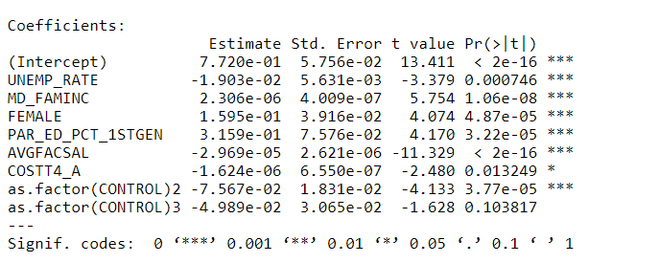
Our new model
ADM_RATE ~ UNEMP_RATE + MD_FAMINC + AVGFACSAL + COSTT4_A + FEMALE + PAR_ED_1STGEN + CONTROL.
e.g of interpretation:
Given all other variables are held constant, for every unit increase in cost per year, admission rate for that school drops by approximately 1.6%.
In other words, more expensive schools are harder to be admitted to.

Slide 7
Our new model Predictors selected primarily according to research, based on those that were statistically related. We think this is a good model since it uses both school characteristics and student demographics. All predictors are significantly related to the response. E.g. Avgfacsal is a good predictor to keep since it corresponds to the caliber of professors at that institution.
Predictor | P-value
Unemp_rate | 0.000746
Md_faminc | 1.06e-08
avgfacsal | < 2e-16
female | 4.87e-05
Costt4_a | 0.013249
Par_ed_1st_gen | 3.22e-05
Control 2 | 3.77e-05
Control 3 | 0.103817

Slide 8
Discussion
According to research, the most influential factors other than grades are student demographics and diversity.
Unemp_rate is preferably used as a predictor in our model as opposed to pct_black etc., because most minority groups reside in areas with higher unemployment rate, so it gives a bigger domain.
Female is also used as part of the diversity aspect of admission criteria.

Slide 9
Assumptions of our Models
We must make assumptions when using linear regression models, if these assumptions hold then the linear model makes sense
Assumptions:
The relationship is linear
Independence of the observations
Errors are normally distributed
Equal variance around the horizontal line

Slide 10
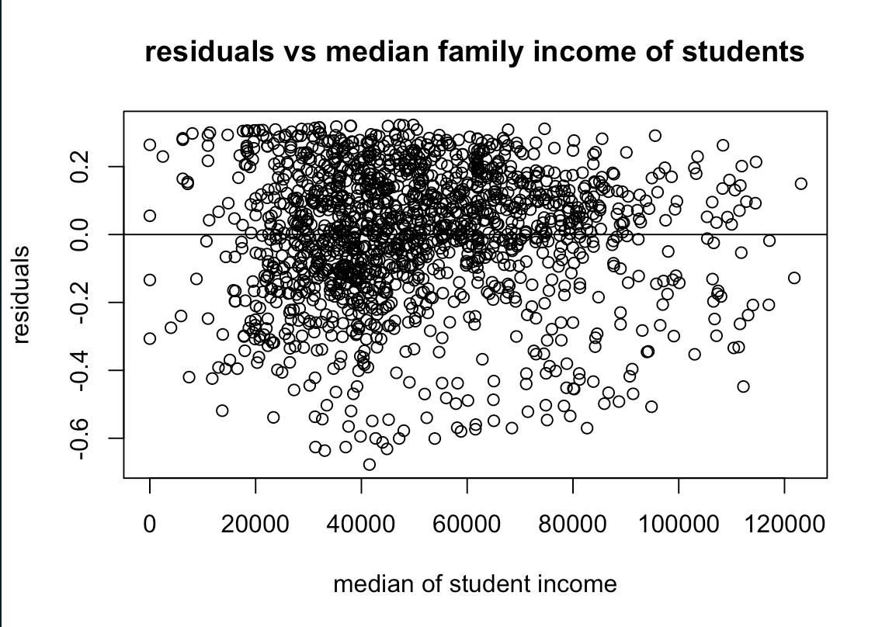
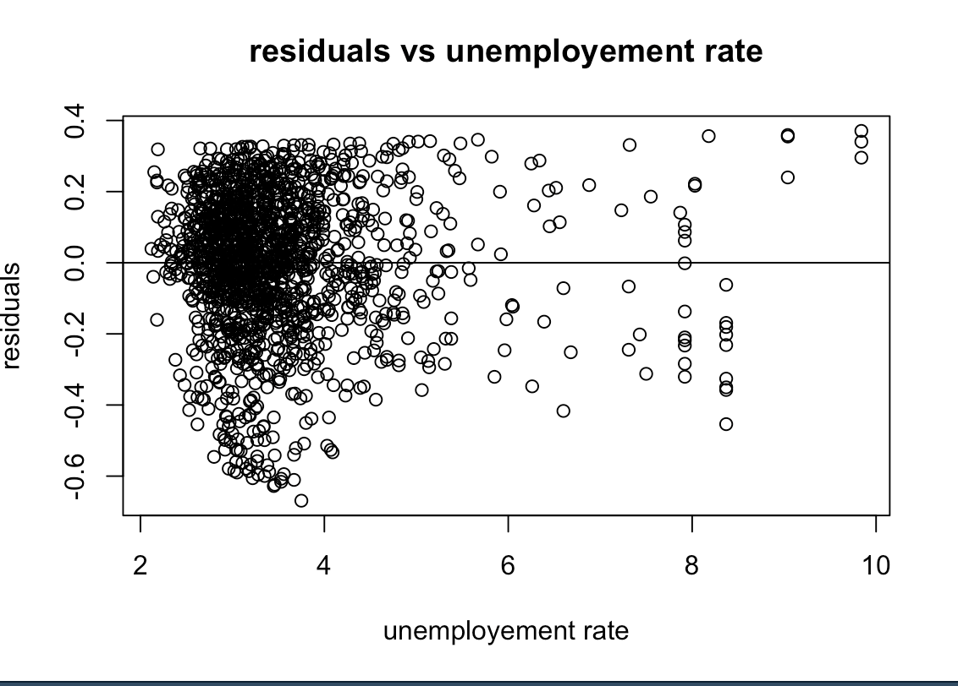
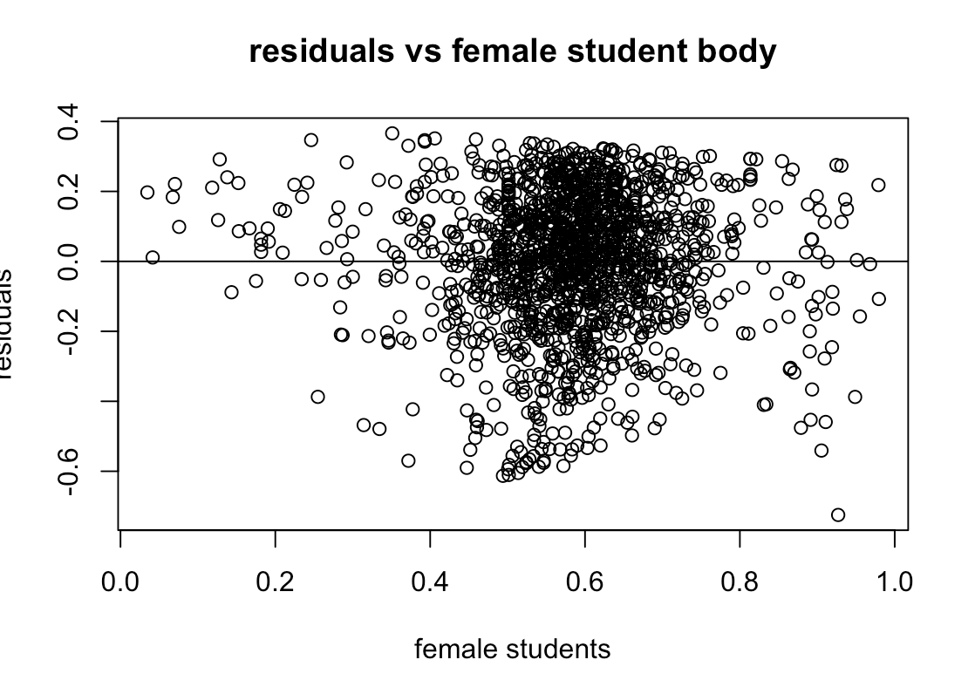
Model Diagnostics
Residuals: the difference between the observed value (y) and the predicted value (x)
Residual plots:
Show if a linear model is a good fit
Should be random meaning no existing pattern
Should be randomly dispersed on the horizontal axis

Slide 11
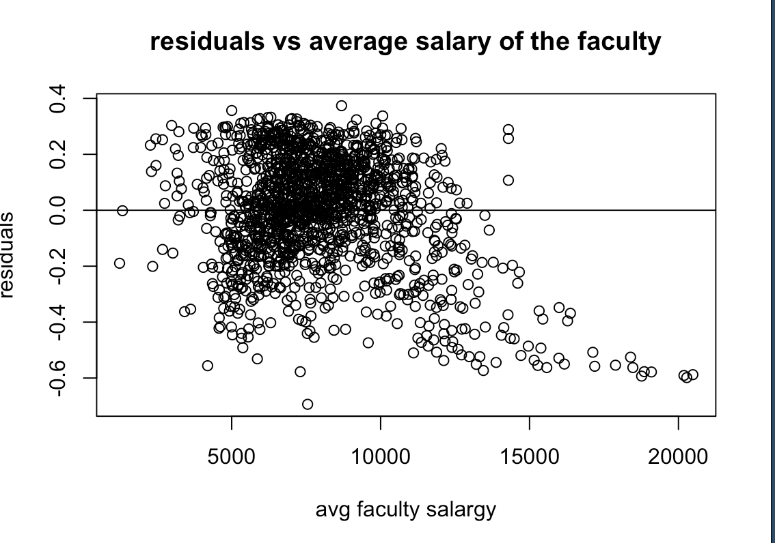
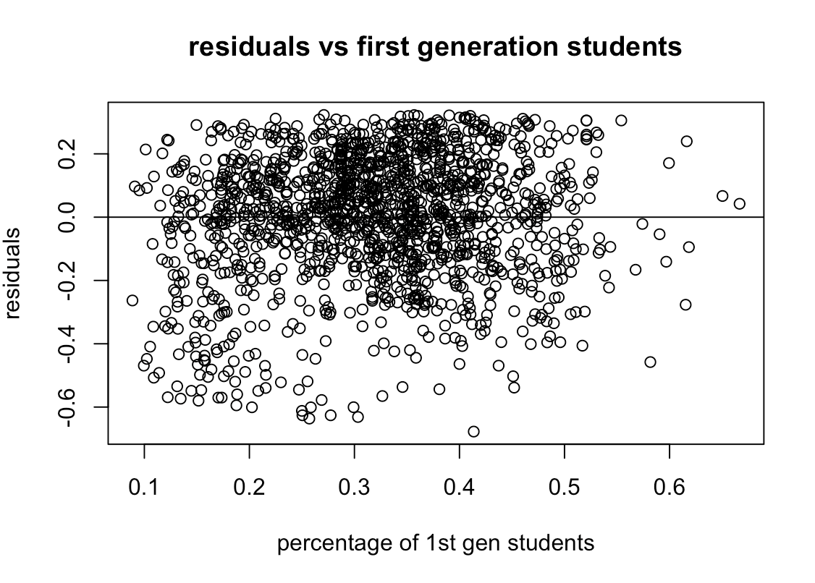
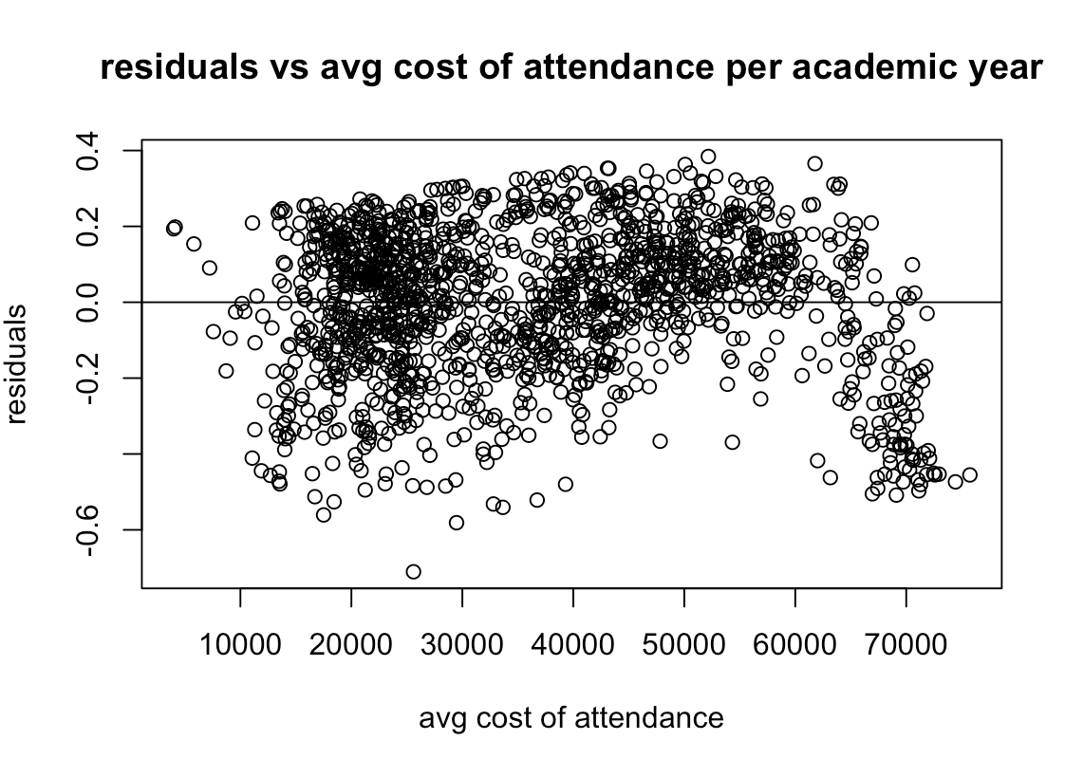
Model Diagnostics
“Horizontal Band”:
The residuals seem to form around the horizontal axis (zero line) meaning that is suggests that the errors of the variance terms are equal
Bounces Randomly:
The residuals bounce randomly around the horizontal axis meaning our assumption that the relationship is linear is sensible

Slide 12
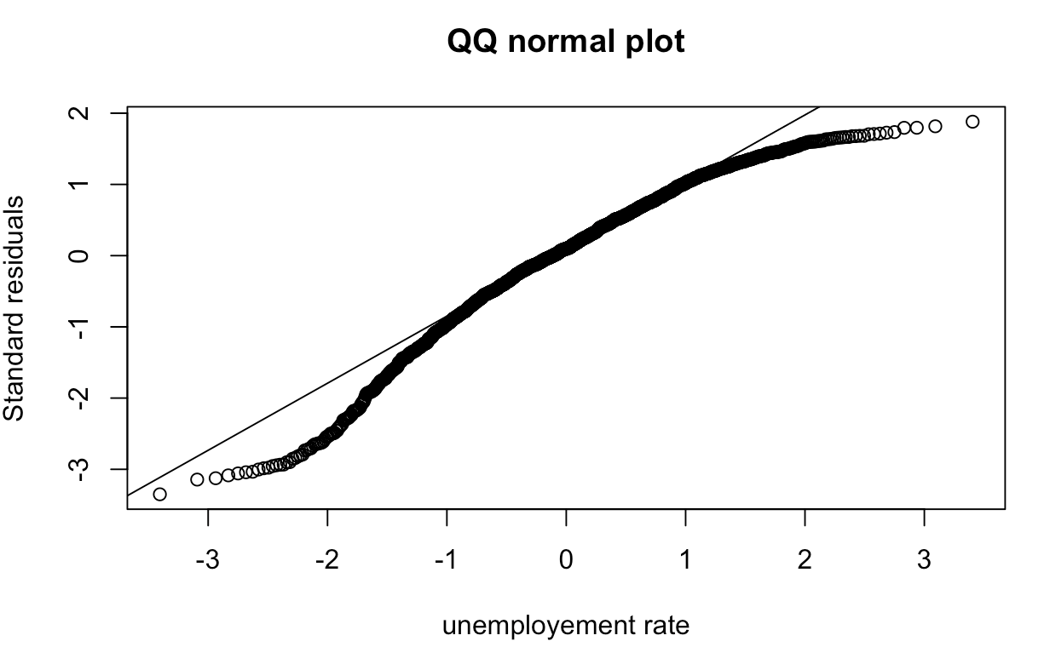
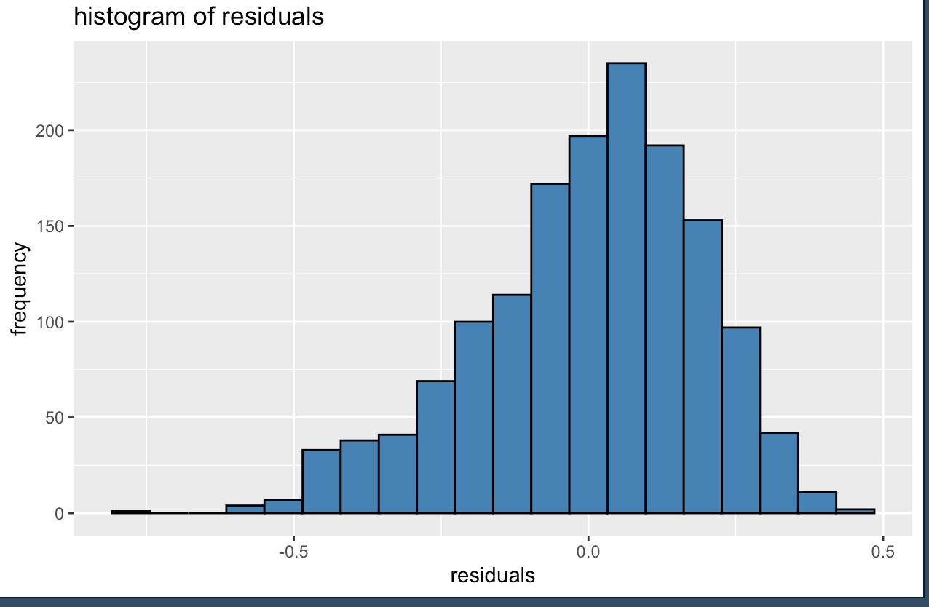
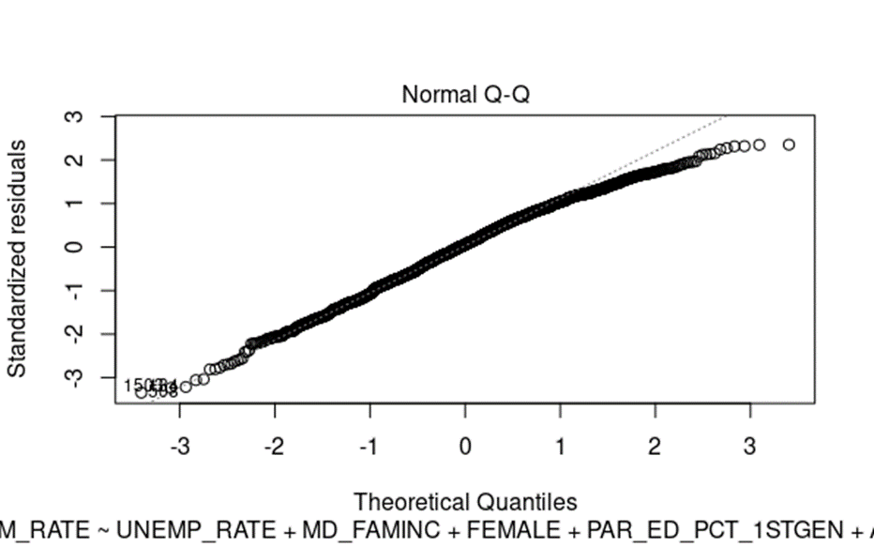
Model Diagnostics – Normality
Histogram:
Bell shaped, uniform, symmetric
QQ plot:
Mostly along the line
Some drifting off at the ends but nothing too alarming

Slide 13
Limitations
Control predictor
Group 3 lost significance due to the introduction of costt4_a predictor.
Might be problematic to get data for avgfacsal.
Difficult to reproduce similar dataset.

Slide 14
Final interpretation
Example of interpretation:
You are more likely to be admitted if you apply to a public school and if you live in an area with low unemployment, have a high family income, school has lower faculty salaries, lower cost per year, high female population and you are a 1st gen student.

Slide 15
References
Andrew S. Belasco & Michael J. Trivette (2015) Aiming Low: Estimating the Scope and Predictors of Postsecondary Undermatch, The Journal of Higher Education, 86:2, 233-263
Espenshade, T. J., Chung, C. Y., & Walling, J. L. (2004). Admission preferences for minority students, athletes, and legacies at elite universities. Social Science Quarterly, 85(5), 1422-1446.
Chapter 3 factors in admission. (n.d.). Retrieved November 14, 2021, from https://www.nacacnet.org/globalassets/documents/publications/research/2018_soca/soca18_ch3.pdf.

